Slide 1


WNS DSC Hackathon
Team E
Matei Banica
Eric Arantes
Hani Abudaba
Lydia Martin
March 2nd, 2023

Slide 2
Team members
Team E (Extraordinary)
Matei - RAN Capacity, Montreal
Eric - RAN Performance, Montreal
Hani - RF Design, Toronto
Lydia - PGA, Toronto

Slide 3
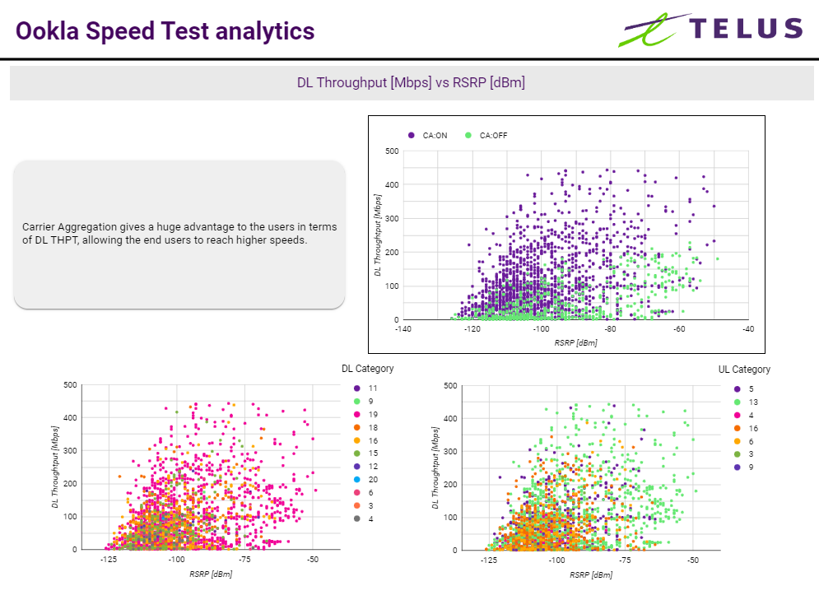
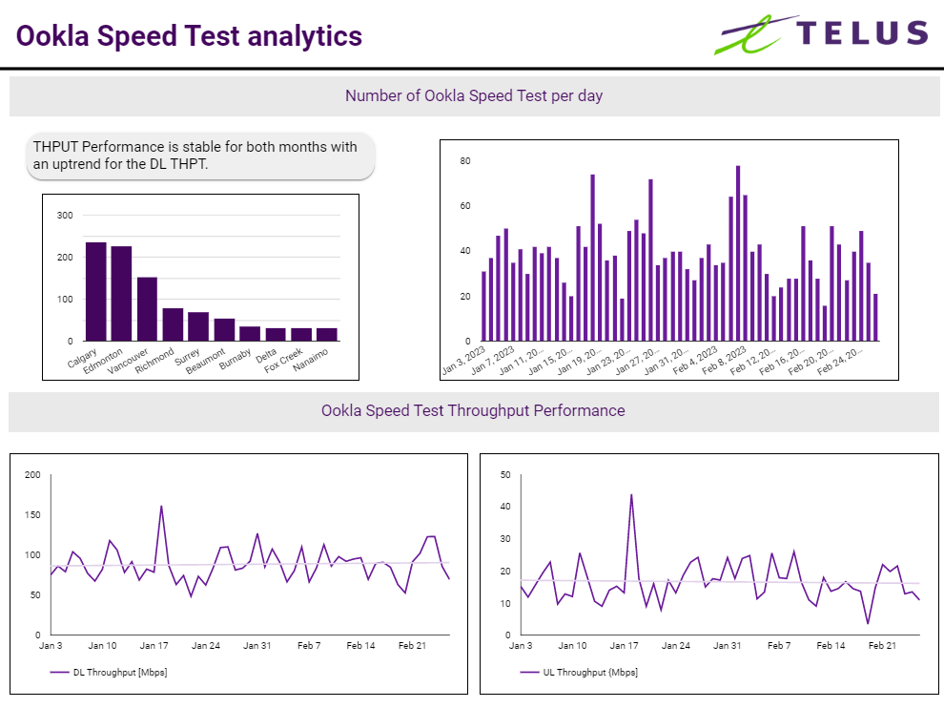
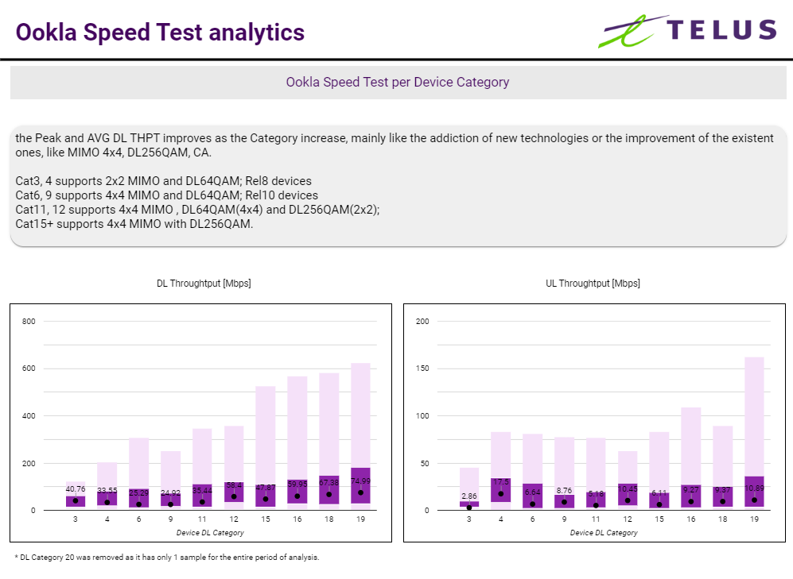
Challenge 1

Slide 4
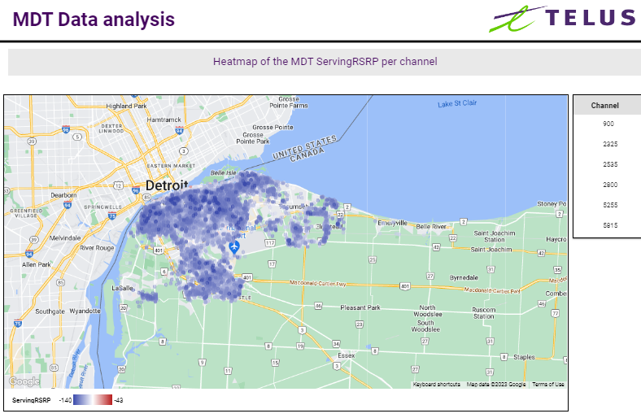
Challenge 3 Part I

Slide 5
Challenge 3 Part II
Things to look at
Linear correlation of MDT ServingRSRP/RSRQ with physical characteristic of the site and the region, like:
Antenna height, MDT, EDT, Gain, HBW and VBW;
Cell Tx power;
Distance to the Site;
Clutter;
Correlation between MDT data (RSRP/RSRQ) and PM KPIs, like Accessibility, Retainability….
Other data that could provide additional insights:
Demographics (population density, types of phone users and devices)
Seasonality (daily, weekly, yearly)
Traffic patterns
Weather
Interference from Telus neighbouring sites or external factors like other operators
Site outages

Slide 6
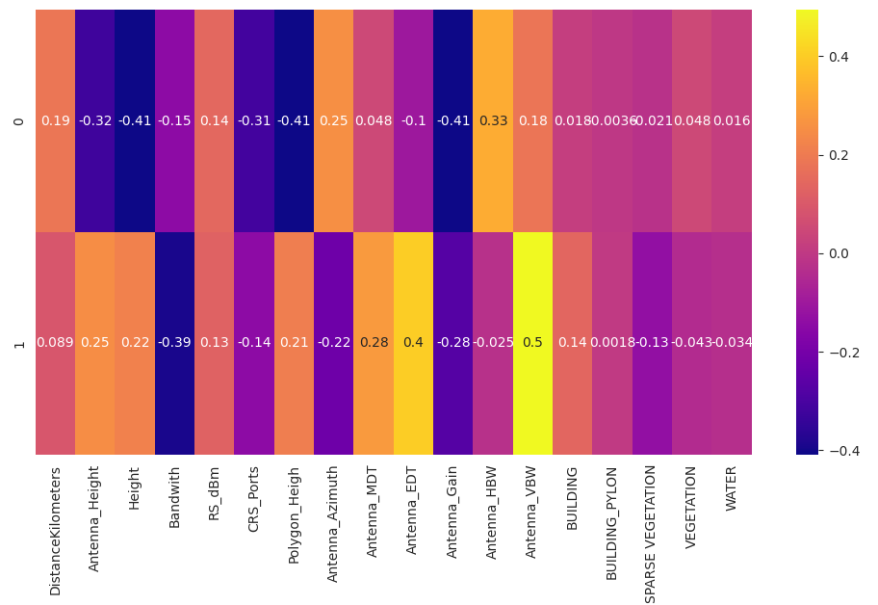
Exploratory Data Analysis
Some significant features found using Principal Component Analysis:
Antenna horizontal and vertical bandwidth
Antenna gain
UE height, polygon height

Slide 7
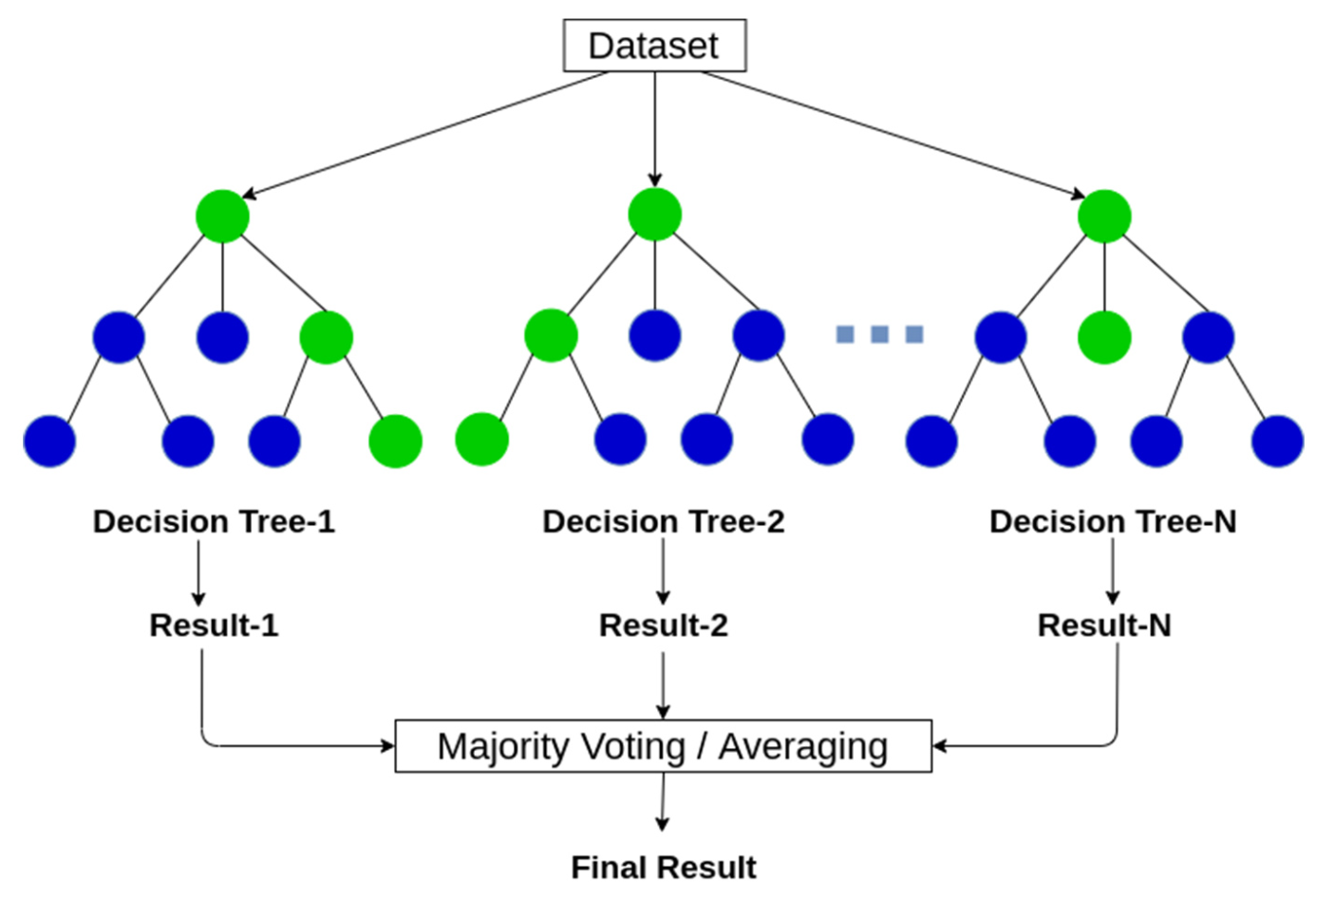
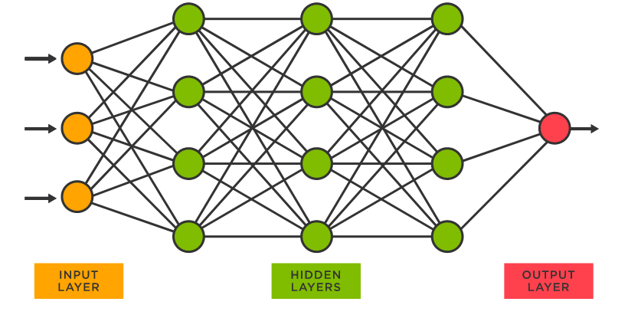
Next Steps
Import additional data (demographics, weather, interference, outages)
Geospatial analysis using Geopandas
Test different nonlinear ML models like Random Forest or neural network
Feature importance analysis
Testing and validation of models
Fail fast approach

